Slide 1
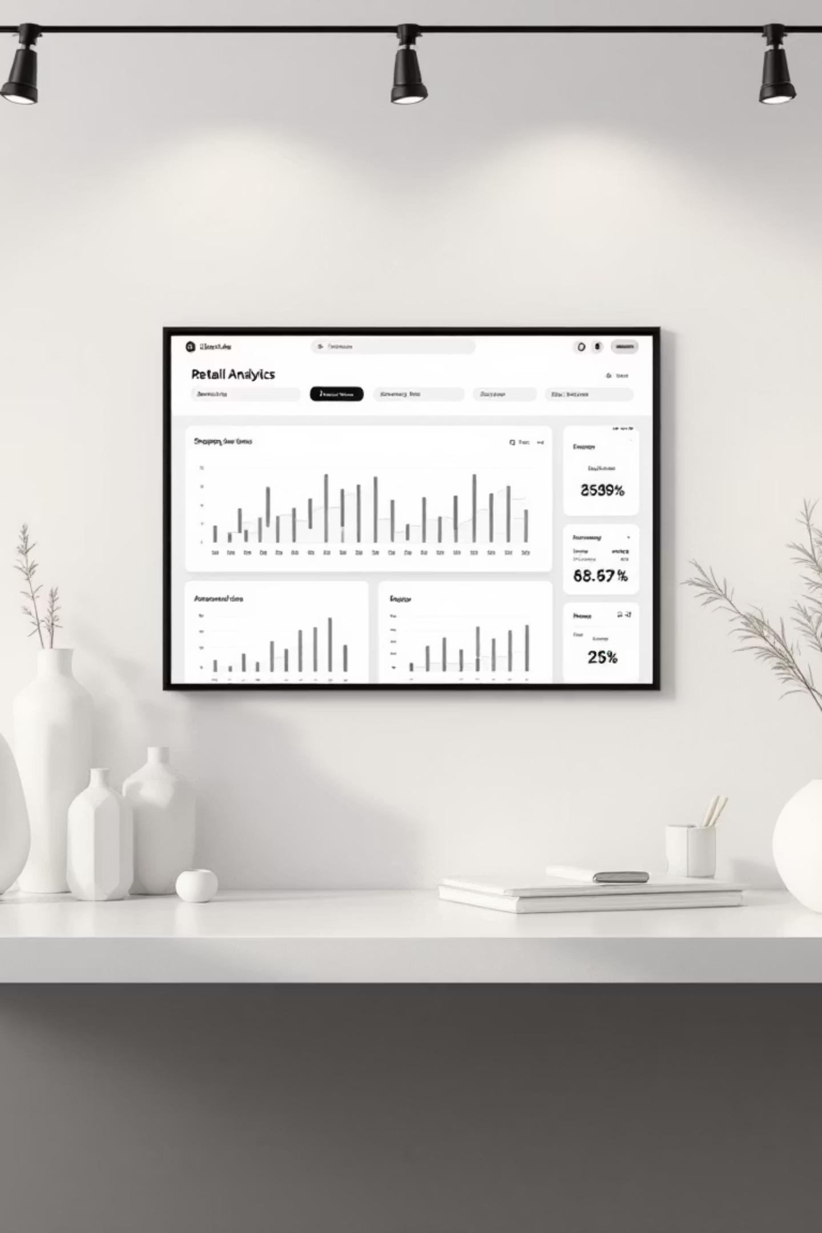
Customer Shopping Behavior Analysis
Uncovering insights from 3,900 purchases to guide strategic business decisions

Slide 2

Dataset Overview
3,900
18
50
Total Purchases
Data Points
Locations
Transactions analyzed
Features per transaction
Geographic coverage
25
Products
Items tracked

Slide 3

Data Preparation & Cleaning
01
02
Data Loading
Initial Exploration
Imported dataset using pandas
Structure check and summary statistics
03
04
Missing Data Handling
Feature Engineering
Imputed 37 missing review ratings using median
Created age groups and purchase frequency columns
05
Database Integration
Loaded cleaned data into PostgreSQL
Standardized columns to snake case for better readability and dropped redundant features

Slide 4

Key Customer Metrics
Average Age
44 years
Range: 18-70 years
Average Purchase
$59.76
Range: $20-$100
Average Rating
3.75 / 5.0
Median: 3.8 stars
Previous Purchases
25 average
Median: 25 orders

Slide 5
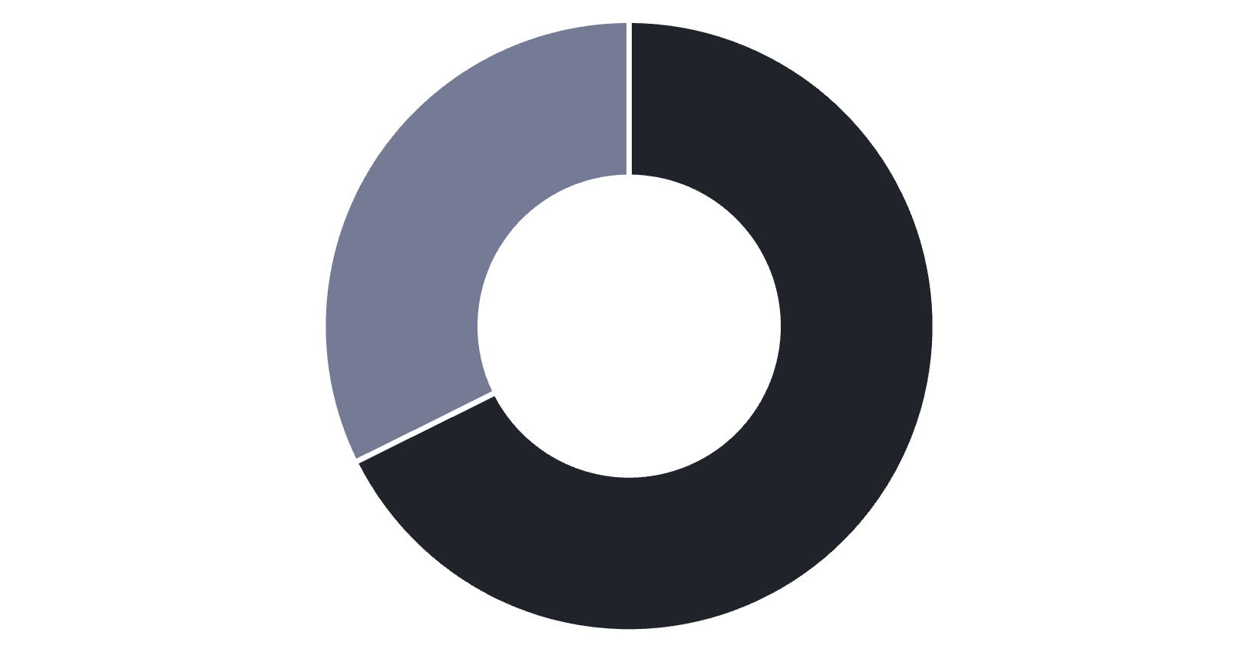
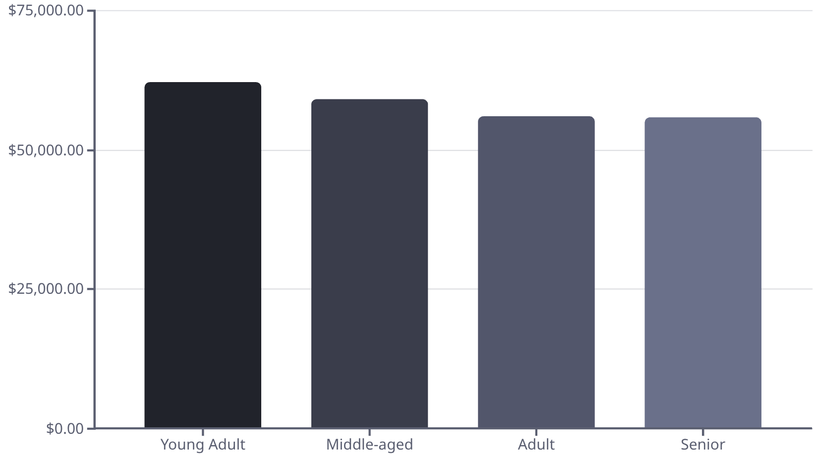
Revenue Analysis
Gender Breakdown
Age Group Revenue
Male
Female
Male customers generate 68% of total revenue
Young adults lead revenue generation across all segments

Slide 6
Product Performance Insights
Top Rated: Gloves
Sandals
Boots
3.86 average rating
3.84 average rating
3.82 average rating
Clothing Dominates
Discount Dependency
1,737 purchases - highest category volume
Hats lead with 50% discount rate, followed by sneakers at 49.66%

Slide 7



Customer Segmentation
New
1
83 customers
Returning
2
701 customers
Loyal
3
3,116 customers
80% of customers fall into the loyal segment, showing strong retention

Slide 8
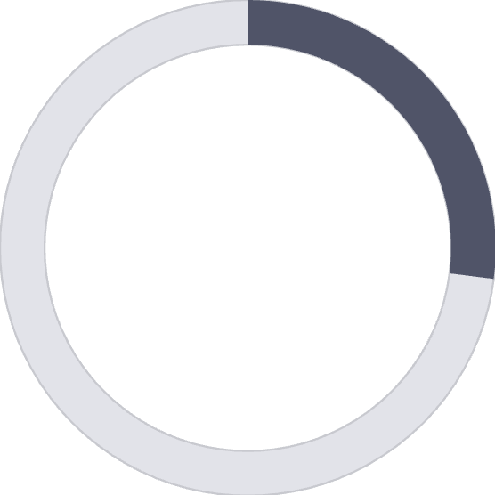

Subscription & Shipping Behavior
Express Shipping
$60.48 avg purchase
27%
Standard Shipping
$58.46 avg purchase
Subscribers
Free Shipping
1,053 customers
Most popular option - 675 orders
73%
Non-Subscribers
2,847 customers
Non-subscribers generate higher total revenue: $170,436 vs $62,645

Slide 9
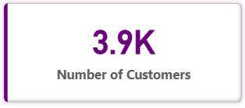
Power BI Dashboard Highlights
Interactive Filters
Visual Insights
Real-Time Metrics
Revenue by category
Subscription status
3.9K customers tracked
Sales by age group
Gender & category
$59.76 avg purchase
Customer distribution
Shipping type
3.75 avg rating

Slide 10





Strategic Recommendations
Customer Loyalty Programs
Reward repeat buyers to move them into loyal segment
Review Discount Policy
Balance sales boosts with margin control
Product Positioning
Highlight top-rated and best-selling products in campaigns
Targeted Marketing
Focus on high-revenue age groups and express-shipping users

